Slide 1
Three photon 1 MHz microscope

Slide 2
Typical specification of the 3p microscope:
Laser: 1300 nm, 1 MHz
Scanner: Resonant-Galvo-Galvo scanner
Power control: Fast power adjustment with EOM (with beam blanking feature)
Overall power throughput: ~ 10 %
Laser pulse duration: 81 fs , with prism pair compressor
Example imaging parameters (flexible):
FOV: 305 um x 305 um
Pixel Resolution: 1.9 um
Size: 160 x 160 pixels
Frame rate: 20 Hz

Slide 3
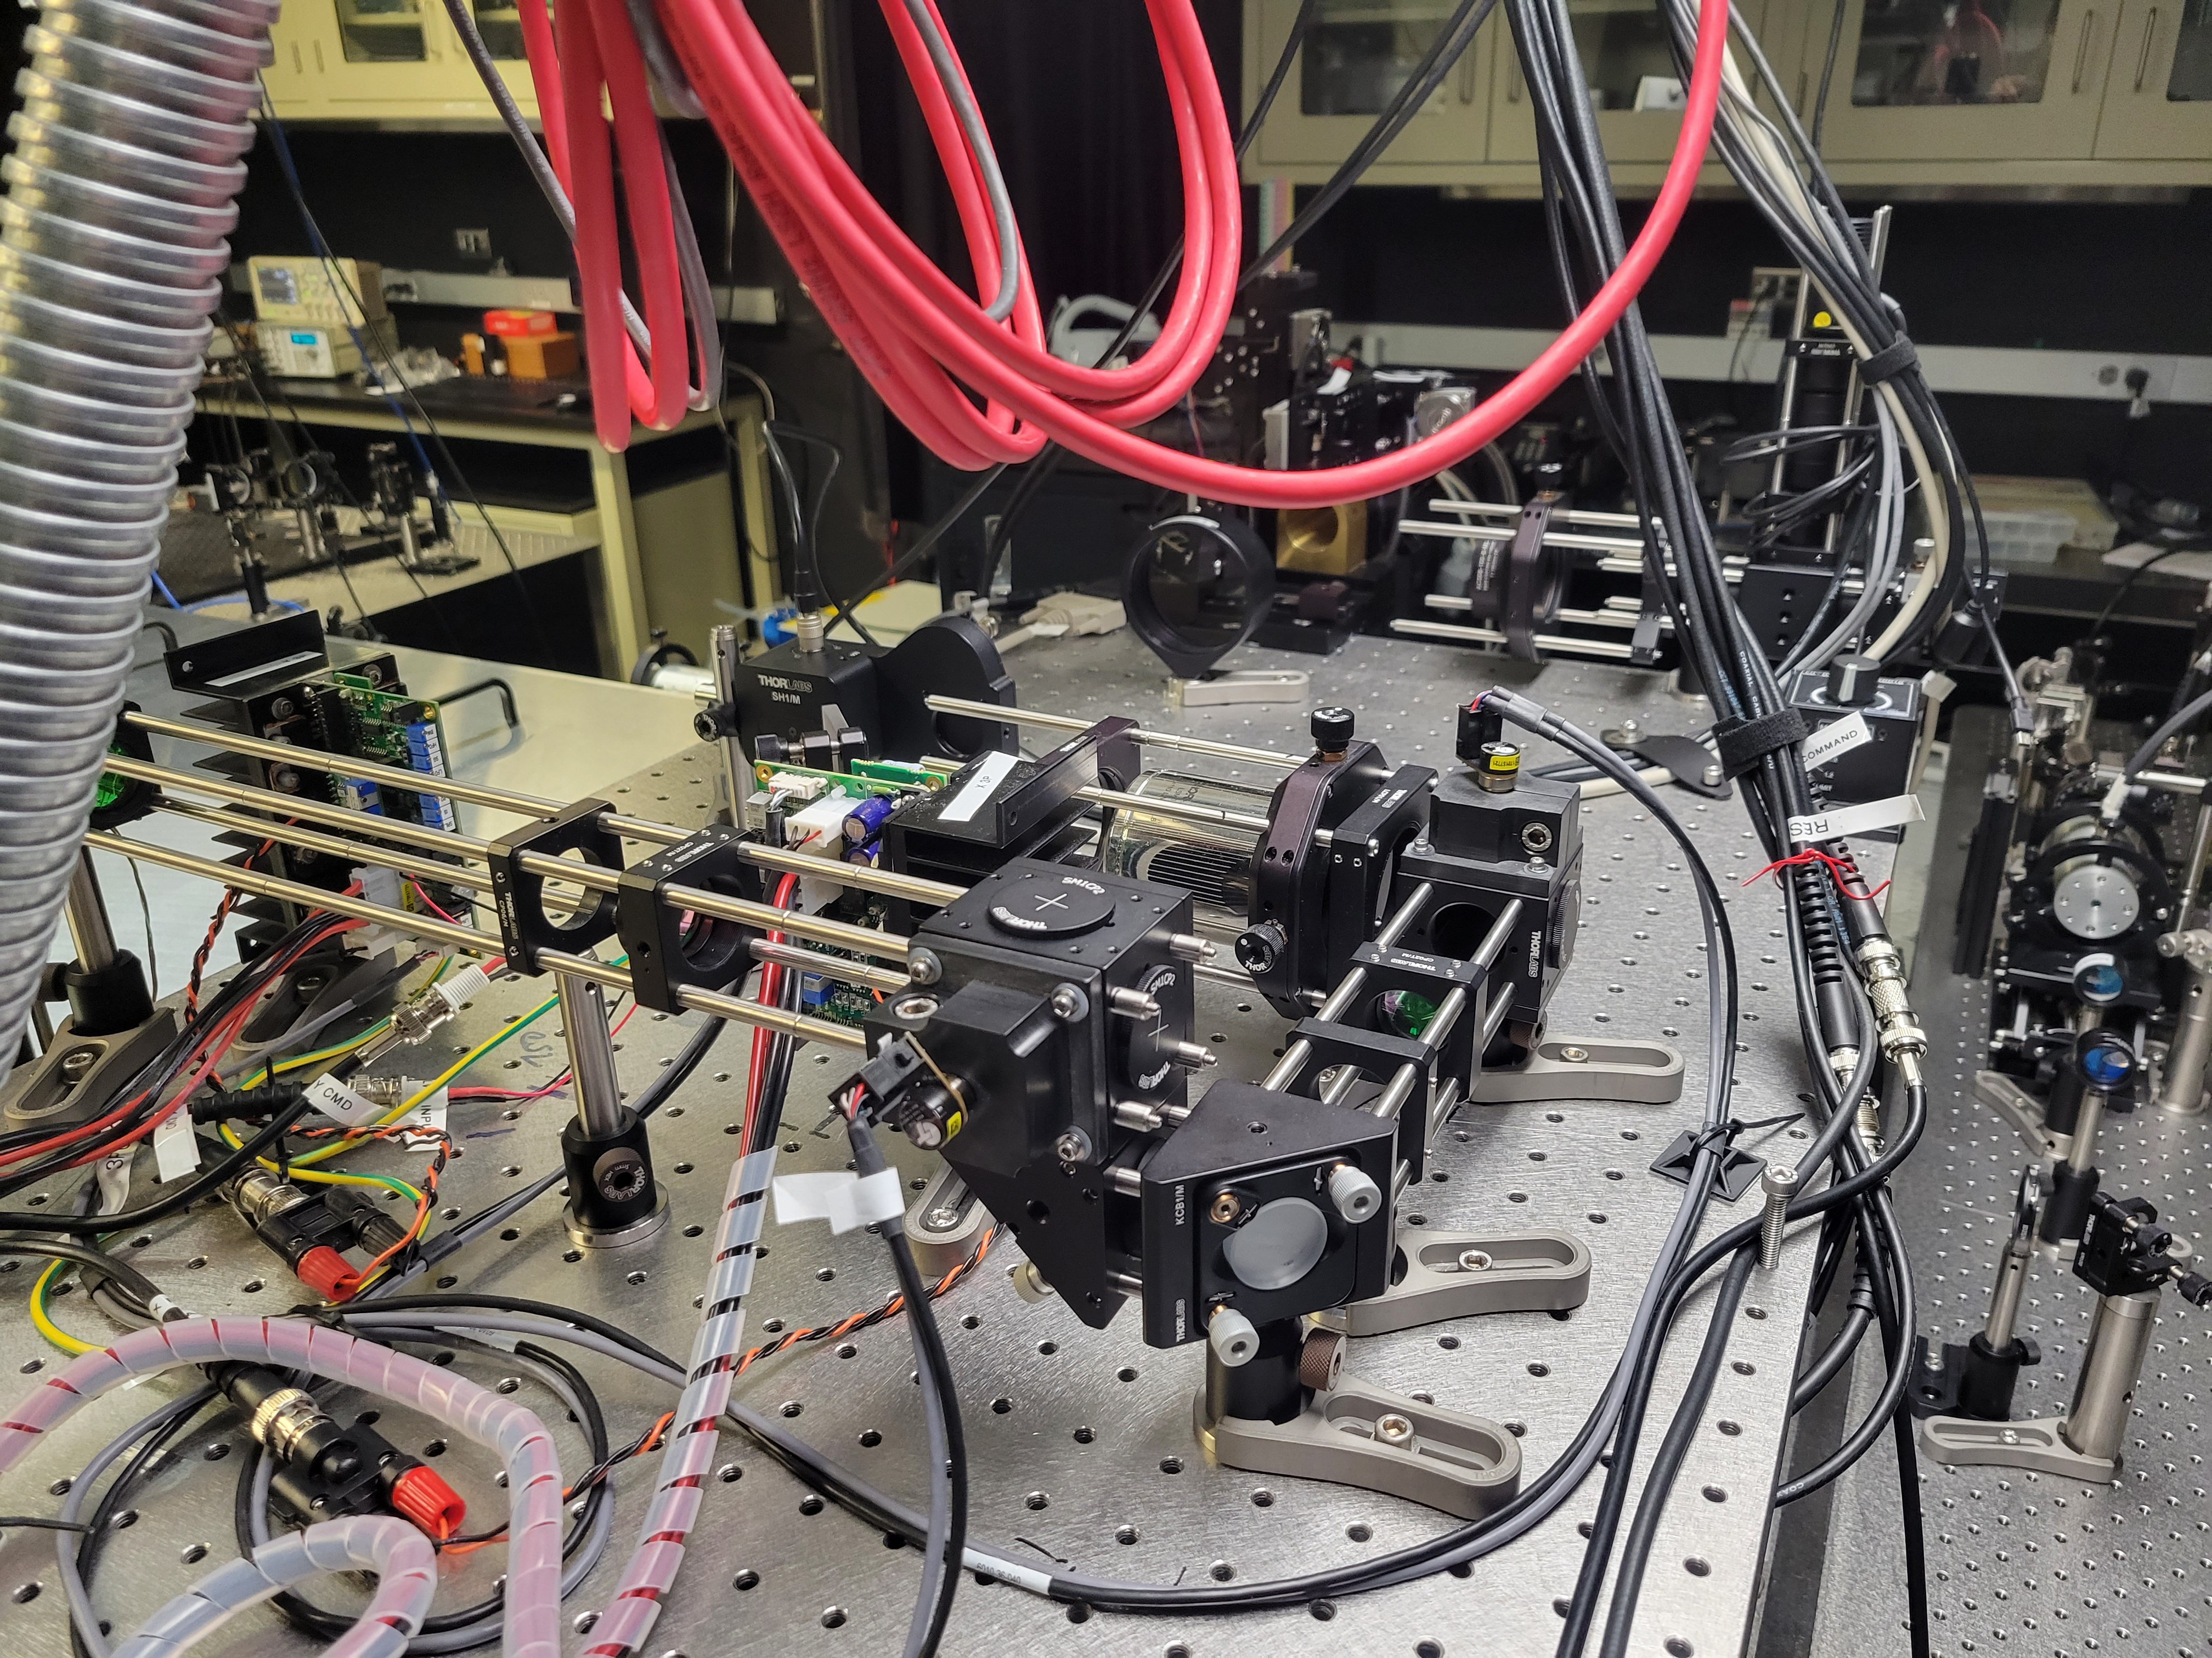
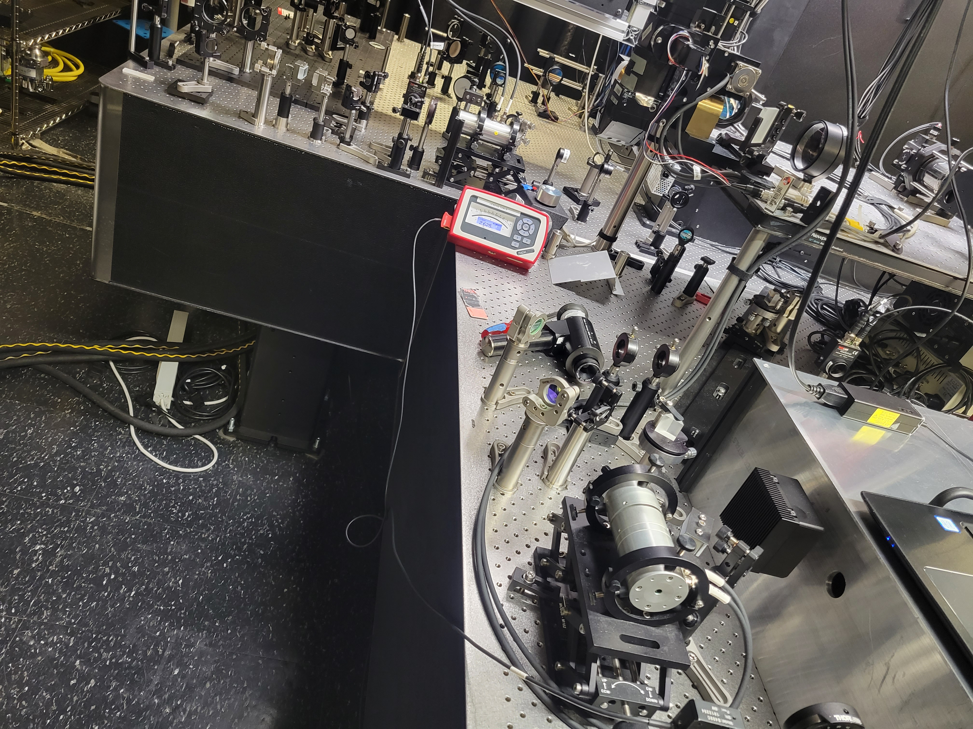
(A)
(B)
M
M
Gy
DC
Rx
Laser
Gx
EOM
Photograph of the three-photon microscope setup with RGG scanner. Rx: Resonant x-scanner, 3 mm, 16 kHz; Gx: Galvo x-scanner, 5 mm; Gy: Galvo y-scanner, 5 mm; M: Microscope head, Sutter, 3-axis stage; EOM: Modulator for power control ; DC: dispersion compensation for laser pulses

Slide 4
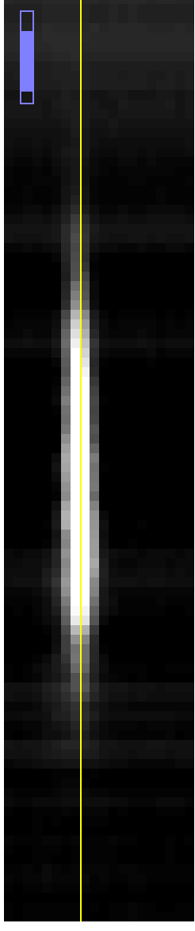
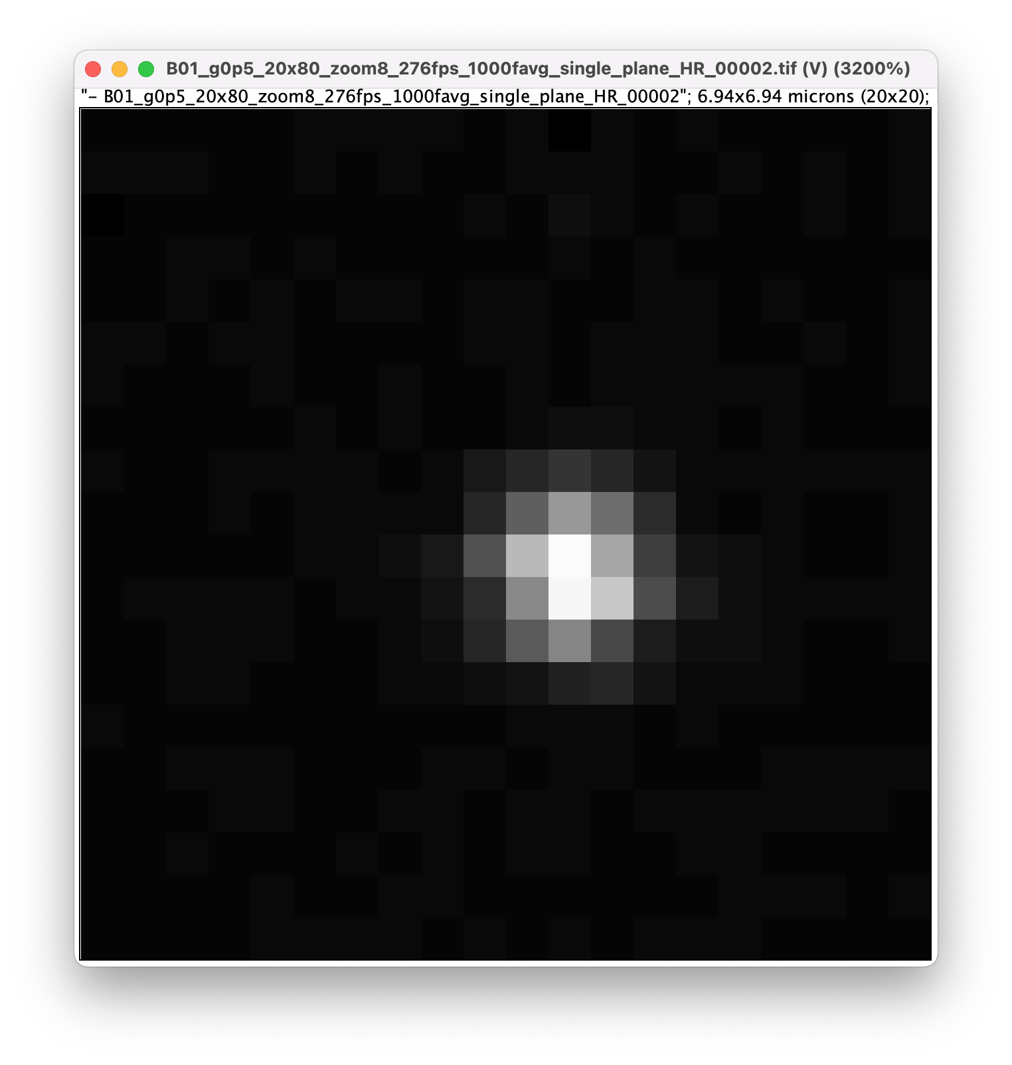
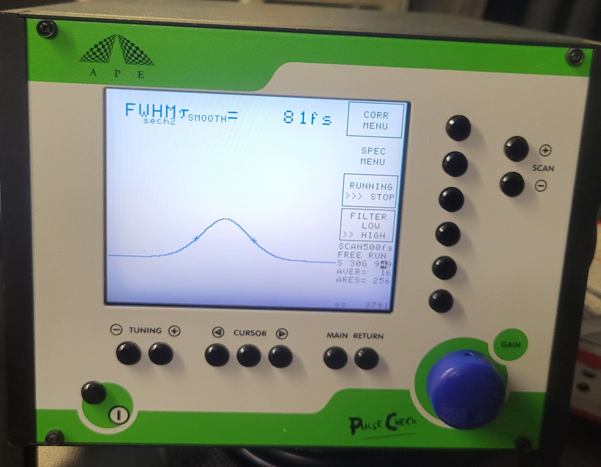
(A)
(C)
(D)
(B)
(E)
Three-photon system characterization. point spread function (PSF) measured with 0.5 um fluorescence beads. (A,B) XY plane cross-section and lateral PSF with FWHM 1.1 um, respectively. (C,D) XZ cross-section and axial PSF with FWHM 9.8 um, respectively. (E) Pulse duration at the sample, 81 fs , with a input laser pulse of 61 fs.

Slide 5
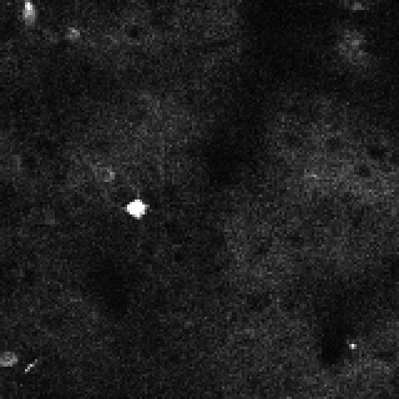
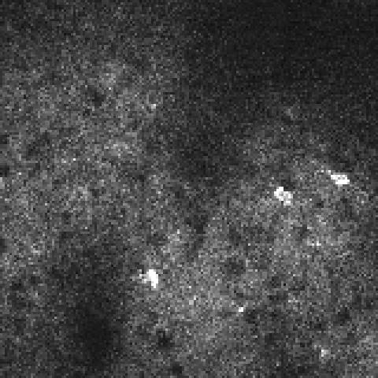


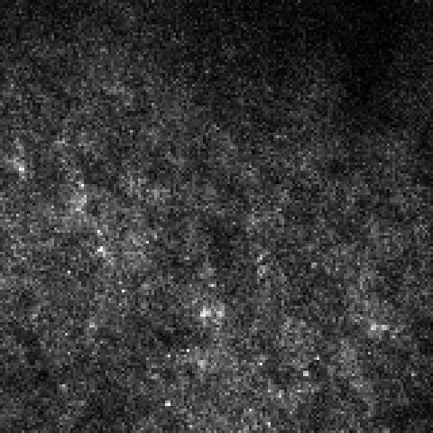

(A)
(B)
(C)
Depth: 280 um; Power: 11 mW
Depth: 500 um; Power: 23 mW
Depth: 600 um; Power: 35 mW
(D)
(E)
(F)
Depth: 700 um; Power: 64 mW
Depth: 800 um; Power: 94 mW
Depth: 900 um; Power: 114 mW
Example video of 3p recording of mouse expression GCaMP6s at the depth from 280-900 um using average power range 11-114 mW. FOV: 305 um x 305 um; Pixel Resolution: 1.9 um ; Size: 160 x 160 pixels; Frame rate: 20 Hz; Duration: 2 min; Immersion medium: water.

Slide 6
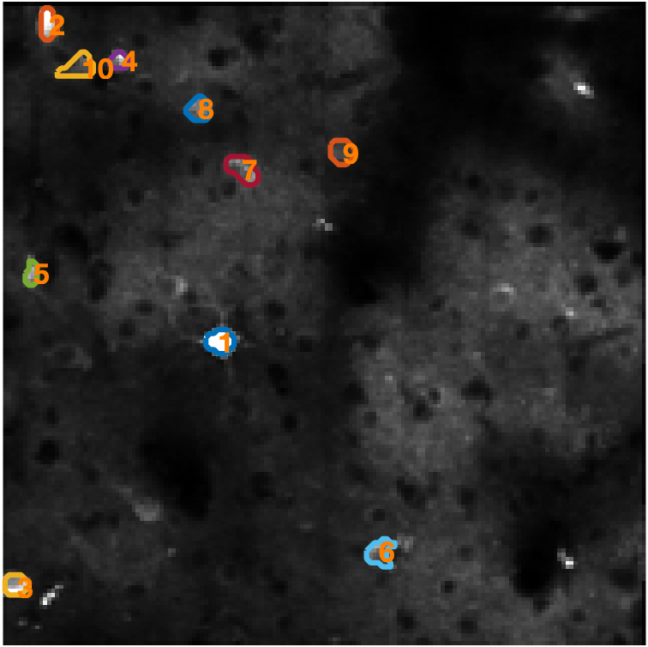
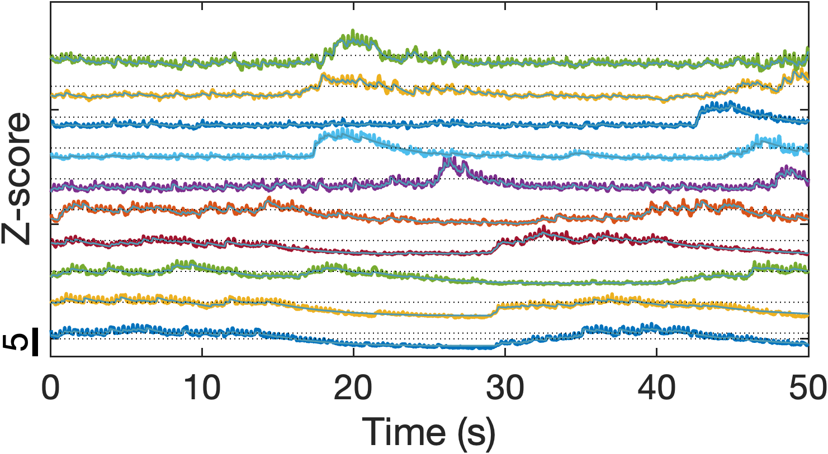
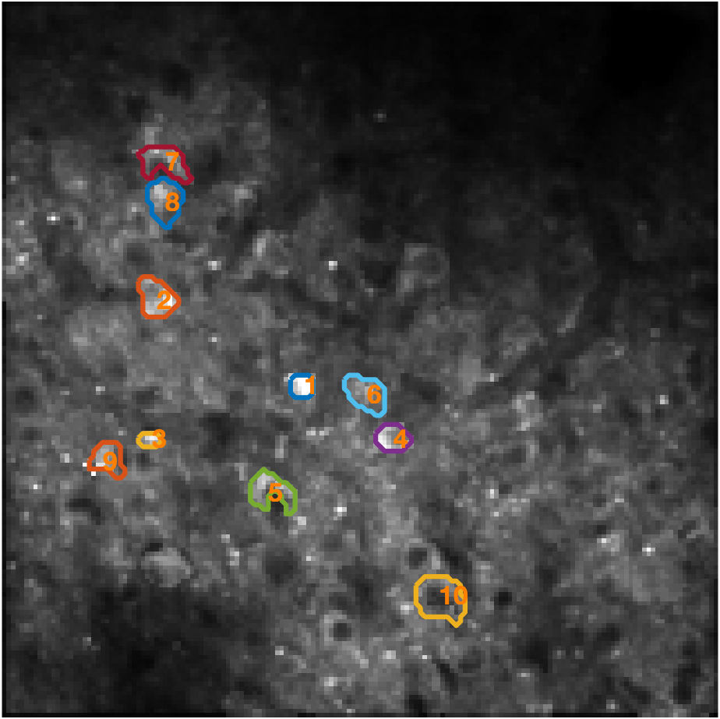
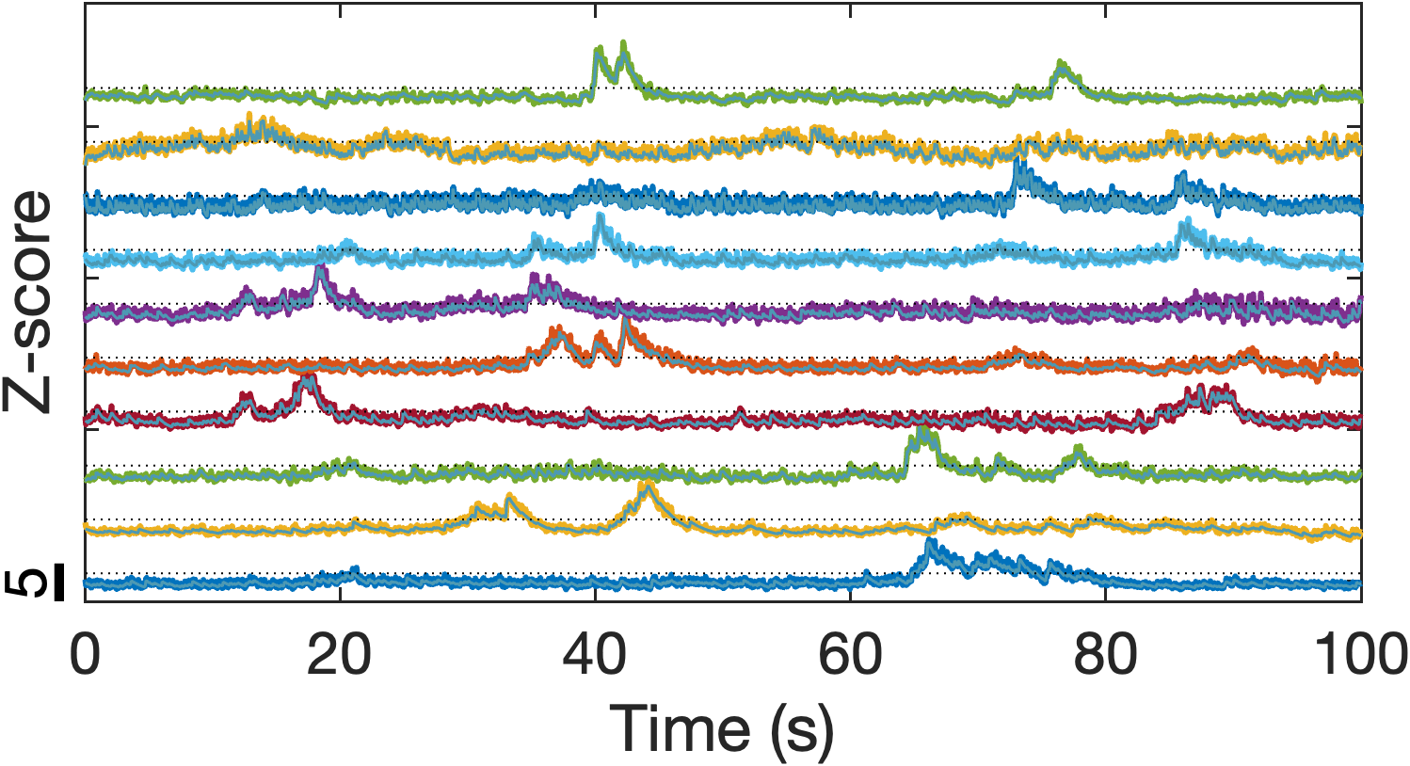
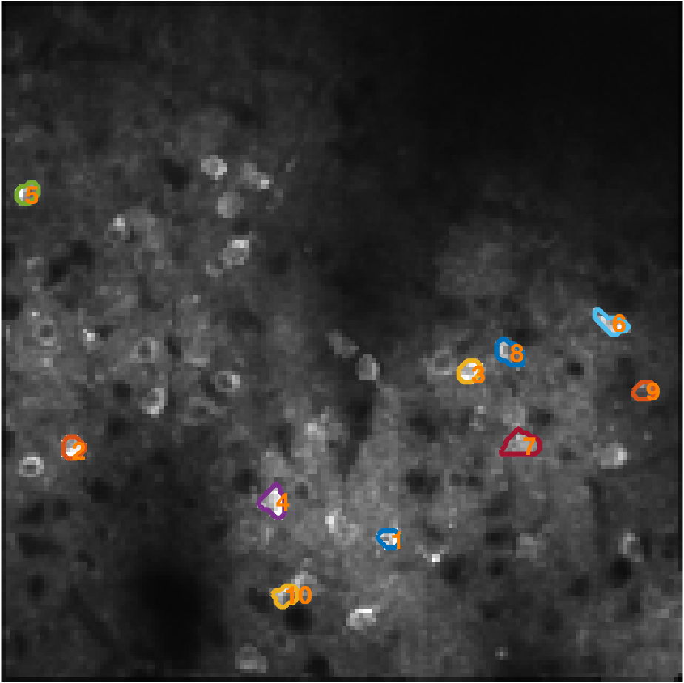
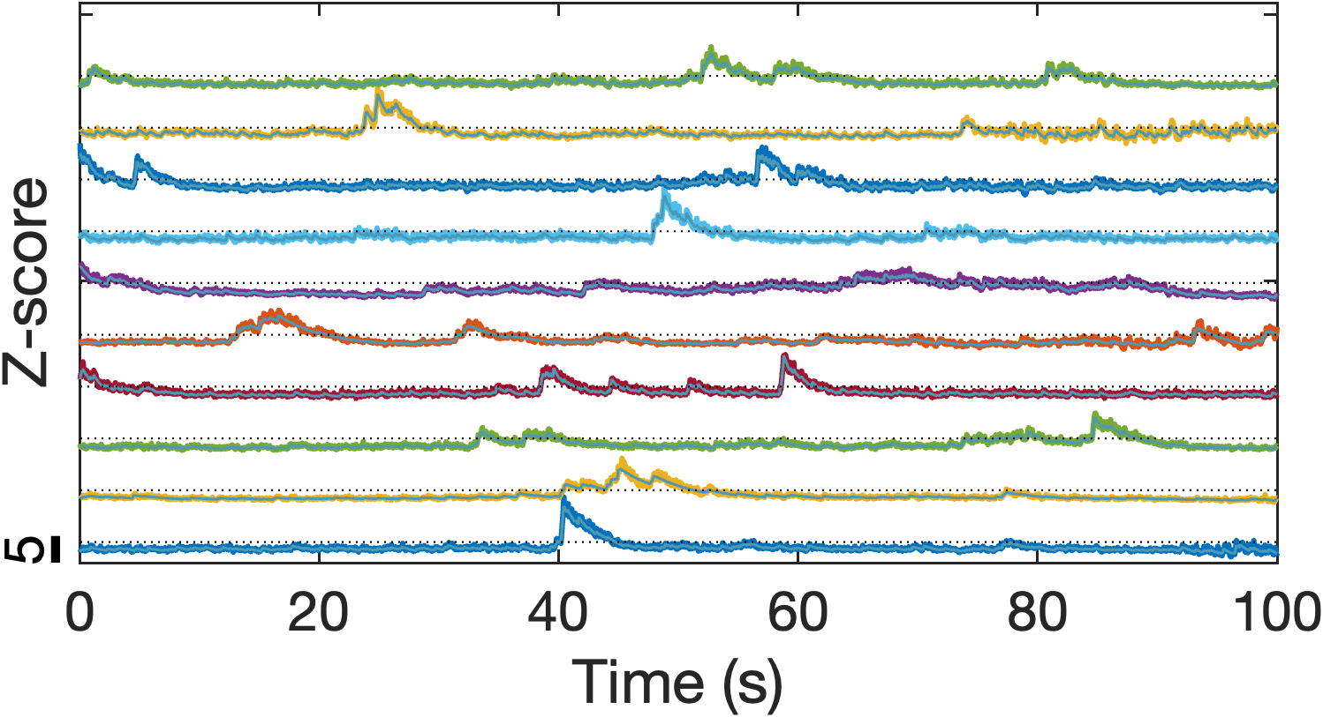
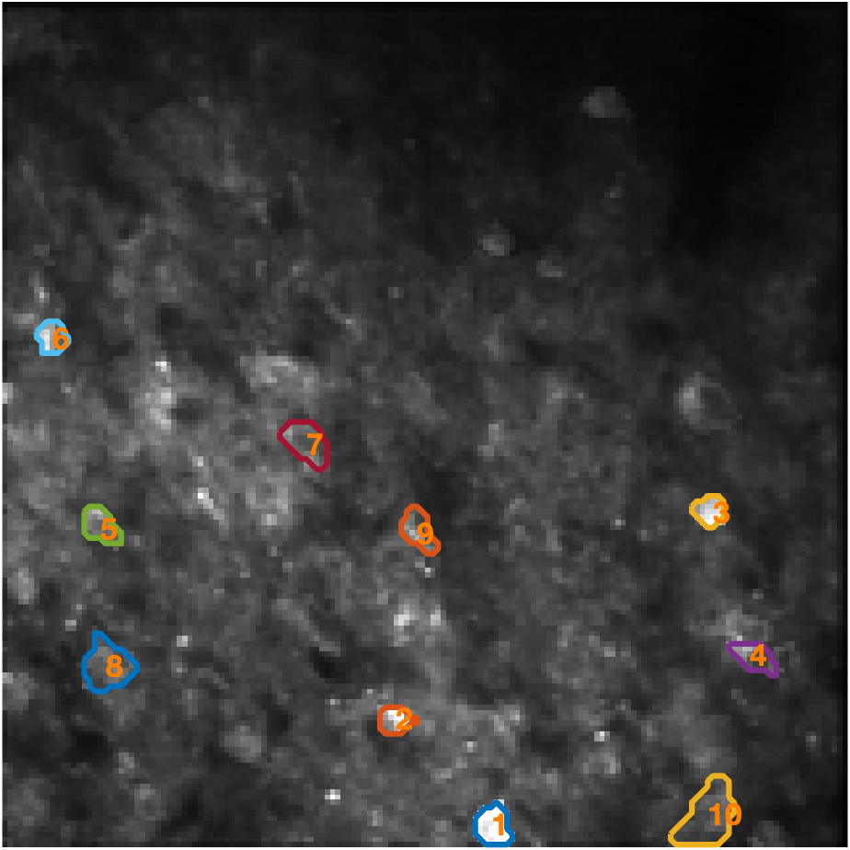
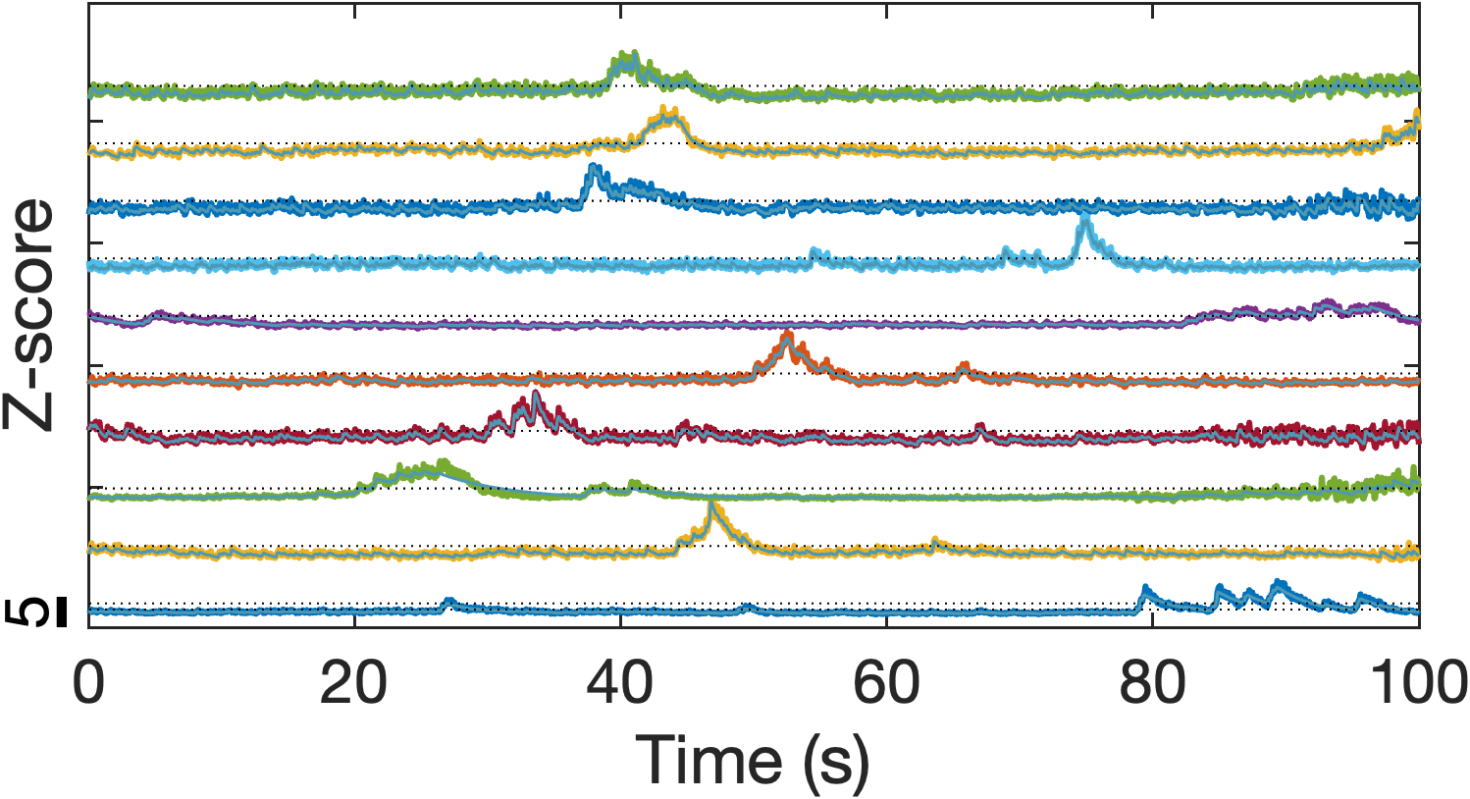
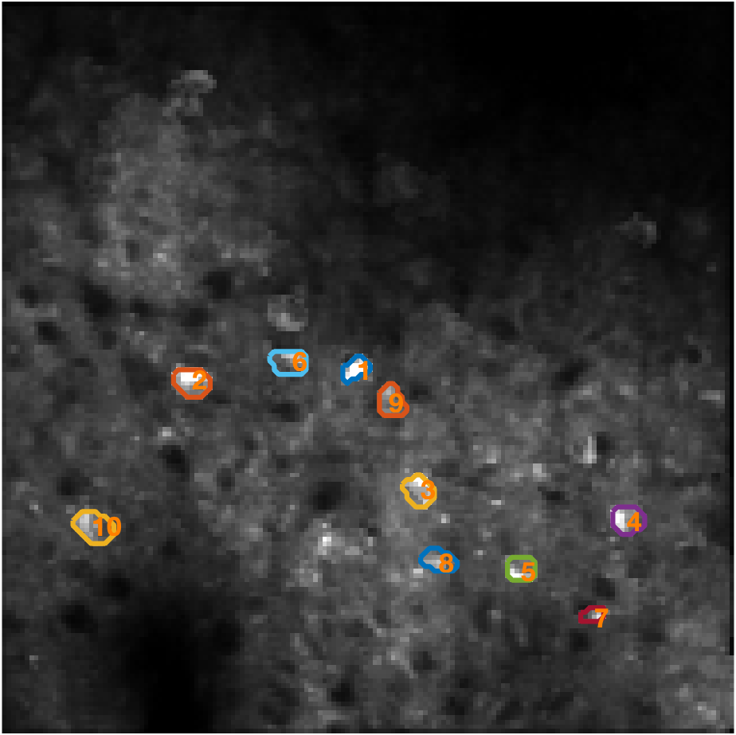
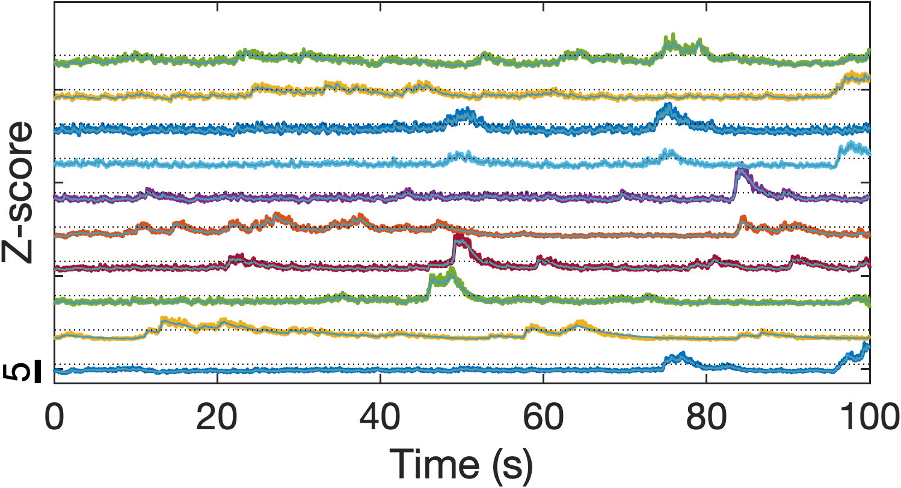
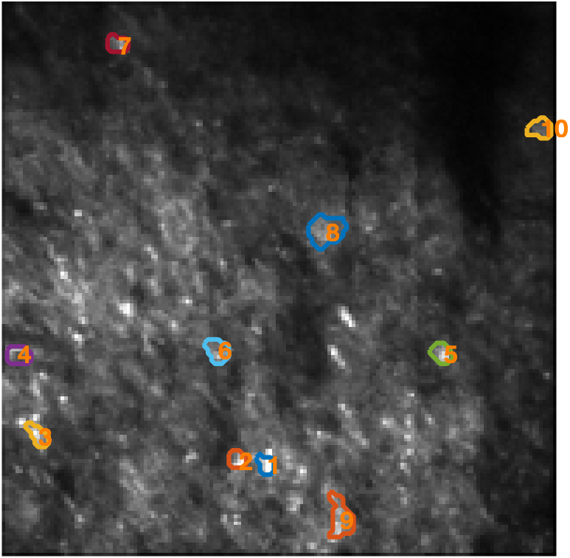
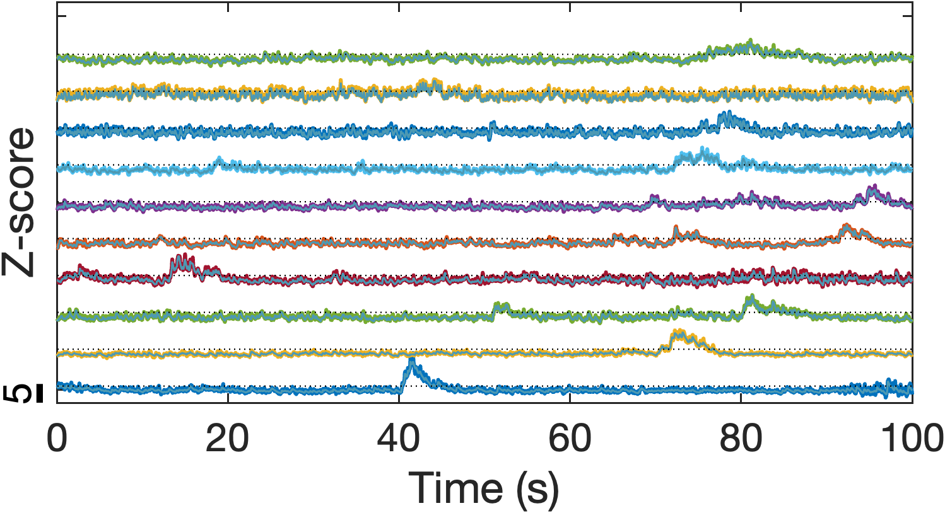
(A)
(B)
(G)
(H)
(C)
(D)
(I)
(J)
(E)
(F)
(K)
(L)
*Caption in next slide

Slide 7
Example 3p recording of mouse expression GCaMP6s. FOV: 305 um x 305 um; Pixel Resolution: 1.9 um ; Size: 160 x 160 pixels; Frame rate: 20 Hz; Duration: 2 min; Immersion medium: water.
(A,B) Mean projection in time and time traces of selected neurons, respectively, at depth 280 um with average power of 11 mW
(C,D) Mean projection in time and time traces of selected neurons, respectively, at depth 500 um with average power of 23 mW
(E,F) Mean projection in time and time traces of selected neurons, respectively, at depth 600 um with average power of 35 mW
(G,H) Mean projection in time and time traces of selected neurons, respectively, at depth 700 um with average power of 64 mW
(I,J) Mean projection in time and time traces of selected neurons, respectively, at depth 800 um with average power of 94 mW
(K,L) Mean projection in time and time traces of selected neurons, respectively, at depth 900 um with average power of 114 mW

Slide 8
Gx
Rx
M
L5
L4
L3
P
L6
M
Gy
SL
S
Laser
TL
HWP
PBS
L1
M
P
M
Sutter
Head
L2
OL
Md
EOM
M
M
M
*Caption in next slide
Sample

Slide 9
Three-photon beam path schematic with resonant-Galvo-Galvo scanner, power control and dispersion compensation module. M, mirrors; HWP, half-waveplate; PBS, polarizing beam-splitter; L1-L2, lenses for telescope to reduce beam size; EOM, electro-optics modulator for power fast power adjustment; Md, D-shaped mirror for beam pick-up; P1-P2, prism-pair for dispersion compensation; Rx, resonance scanner x-axis, 3 mm; Gx, Galvo scanner x-axis, 5 mm; Gy, Galvo scanner y-axis, 5 mm; L3-L4, relay lens pair f = 100 mm; L5-L6, relay lens pair f = 50 mm; SL, scan lens f = 110 mm; TL, tube lens, f = 400 mm; S, laser shutter; OL, objective lens; Microscope, Sutter 3-axis head with detection optics and PMT.

